Slide 1

Basics of HTML
HTML is the standard markup language for web pages and web applications.
With HTML you can create your own Website.
HTML stands for HYPERTEXT MARKUP LANGUAGE.
Extension of HTML file is .html
It tells a web browser how to display the text, images and other form of multimedia on a webpage.
HTML elements are represented by tags
Container Tag/ Pair Tag: The first tag in a pair is the start tag, the second tag is the end tag. The end tag is written like the start tag, with a forward slash before the tag name.
Start and end tags are also called opening tags and closing tags. For ex <b> and </b>
Empty Tag: Only opening tag is used. For ex <br> or <hr>

Slide 2
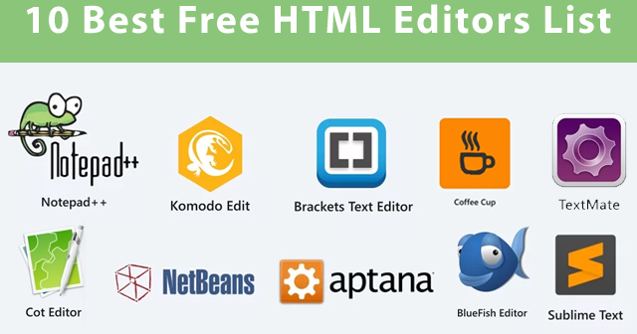
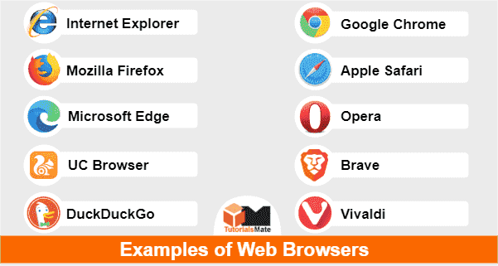
What do I need to create HTML?
Computer
Text or HTML editor: For ex, HTML editors are Dreamweaver, SeaMonkey, Coffee Cup, TextPad etc.
The text editors are include Notepad(for windows), Pico(for Linux), or Simpletext/ text Edit/TexT.
Web Browser. For Ex Internet Explorer of Firefox

Slide 3
HTML VERSIONS
HTML 1991
HTML 2.0 1995
HTML 3.2 1997
HTML 4.01 1999
XHTML 2000
HTML 5 2014

Slide 4
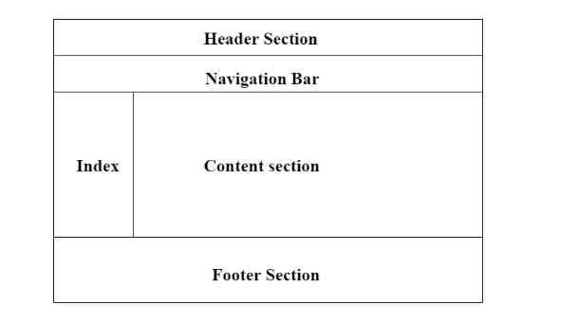
Web Page Layout Using HTML
Page layout is the part of graphic design that deals with the arrangement of visual elements on a page.
Page layout is used to make the web pages look better.
It establishes the overall appearance, relative importance, and relationships between the graphic elements to achieve a smooth flow of information and eye movement for maximum effectiveness or impact.

Slide 5
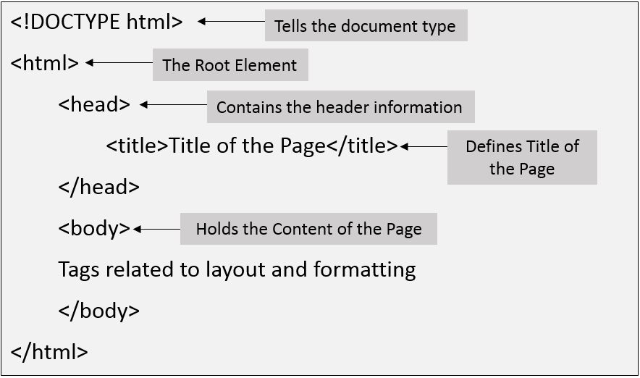
Structure of HTML page

Slide 6
Example Explained (Basic tags)
The <!DOCTYPE html> declaration defines that this document is an HTML5 document
The <html> element is the root element of an HTML page
The <head> element contains meta information about the HTML page
The <title> element specifies a title for the HTML page (which is shown in the browser's title bar or in the page's tab)
The <body> element defines the document's body, and is a container for all the, such as headings, paragraphs, images, hyperlinks, tables, lists, etc. visible contents
The <h1> element defines a large heading
The <p> element defines a paragraph

Slide 7
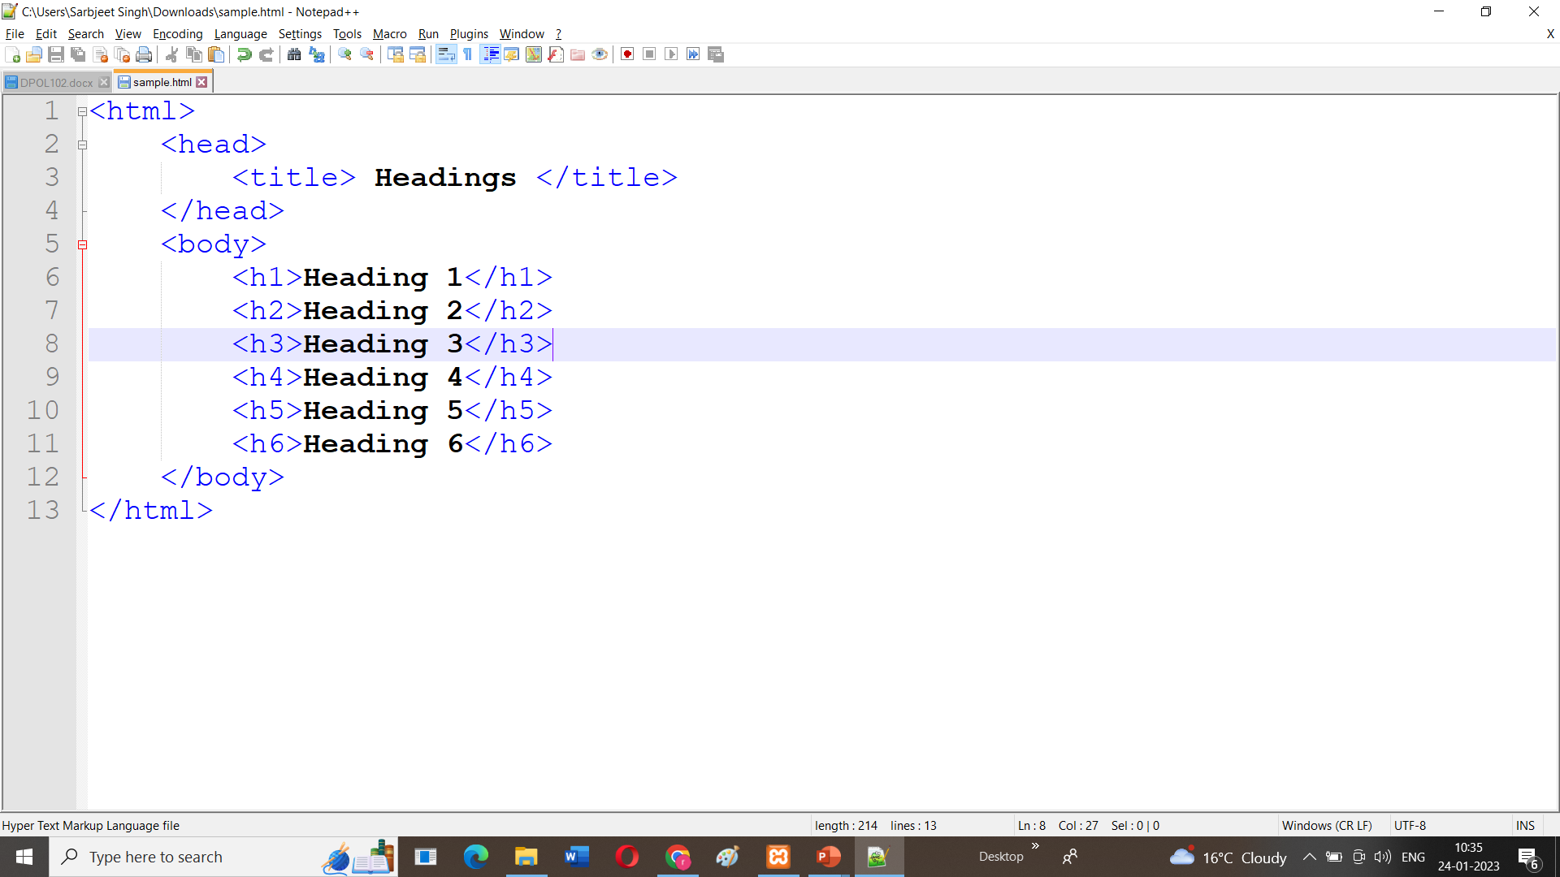
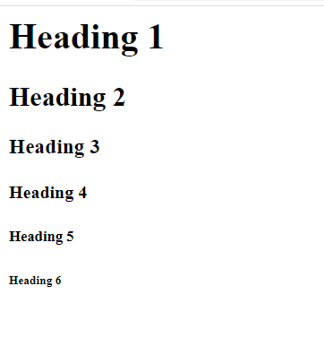
Heading Tags
We are having 6 heading tags
From h1 to h6
<H1> having the highest heading and <H6> having the smallest.

Slide 8
HTML Paragraphs
<p> is used to start the paragraph and </p> tag is used to close the paragraph.
It always starts on a new line and add some space as margin before and after the paragraph.

Slide 9
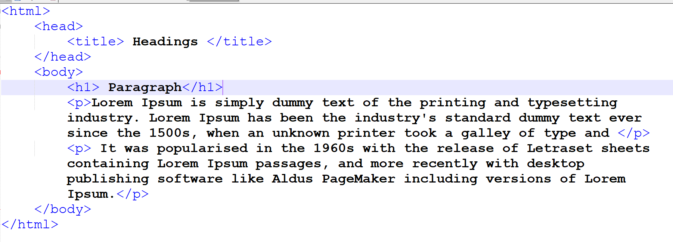
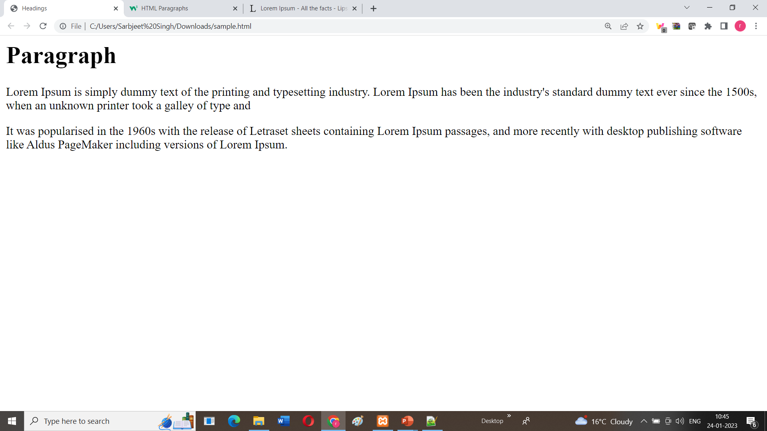

Slide 10
Formatting tags
<acronym> Not supported in HTML5. Use <abbr> instead. Defines an acronym
<abbr> Defines an abbreviation or an acronym
<address> Defines contact information for the author/owner of a document/article
<b> Defines bold text
<bdi> Isolates a part of text that might be formatted in a different direction from other text outside it
<bdo> Overrides the current text direction
<big> Not supported in HTML5. Use CSS instead. Defines big text
<blockquote> Defines a section that is quoted from another source
<cite> Defines the title of a work
<code> Defines a piece of computer code

Slide 11
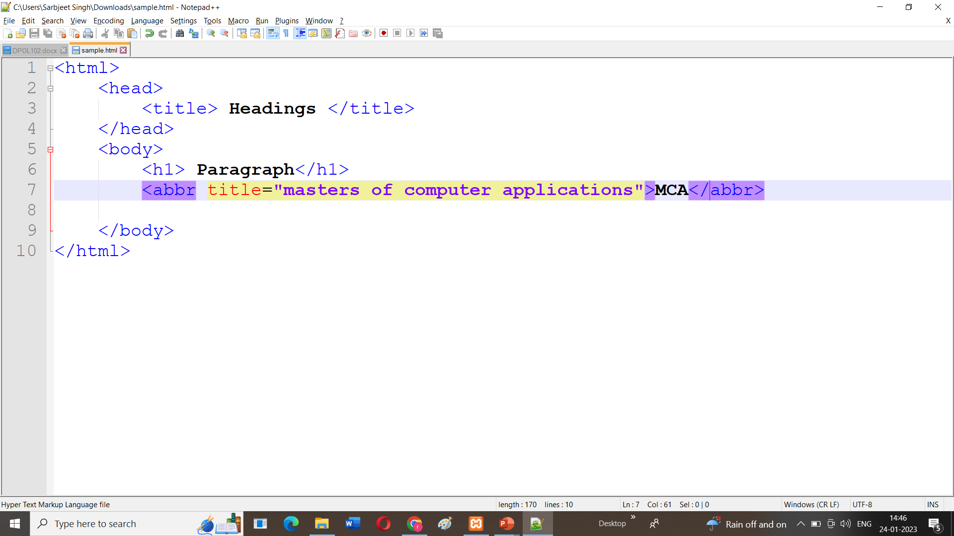
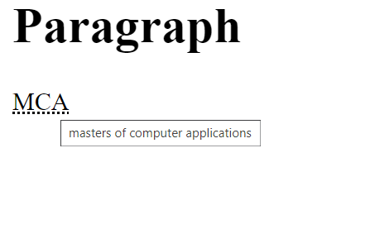
<Abbr> tag
Defines an abbreviation or an acronym
Title is used as its attribute

Slide 12
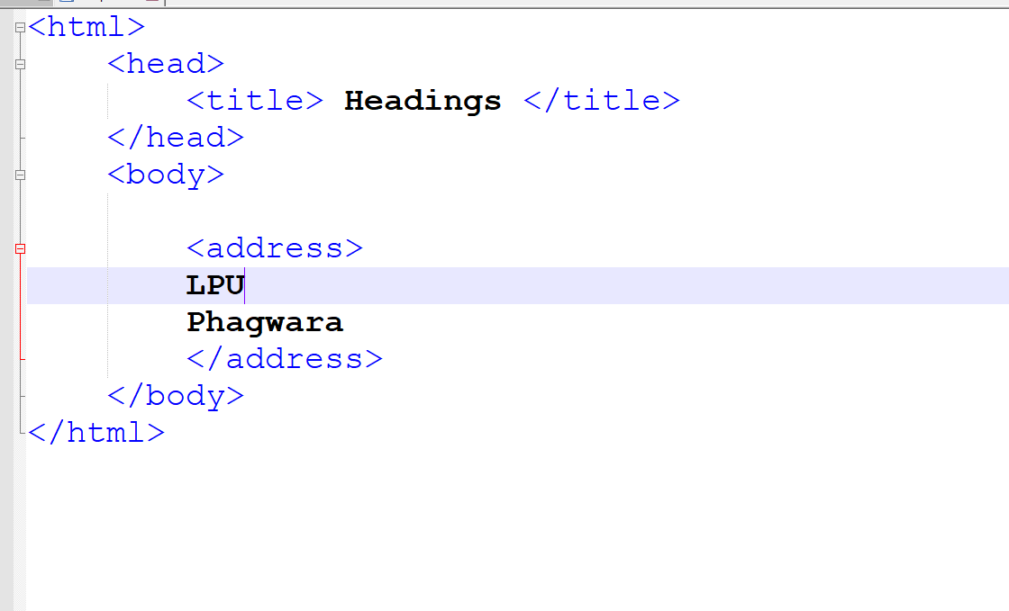
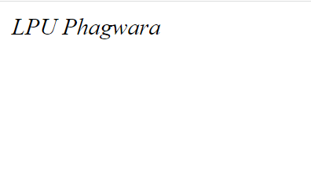
Address Tag
Address is used show the address on the screen

Slide 13
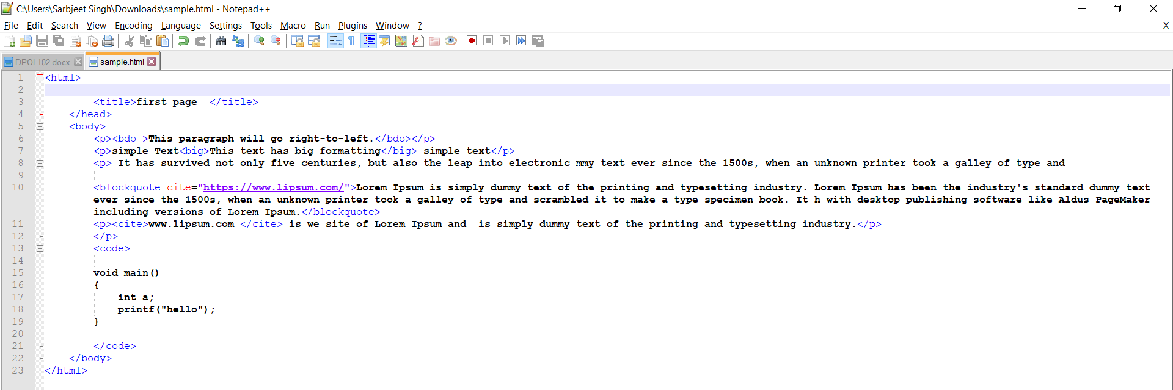
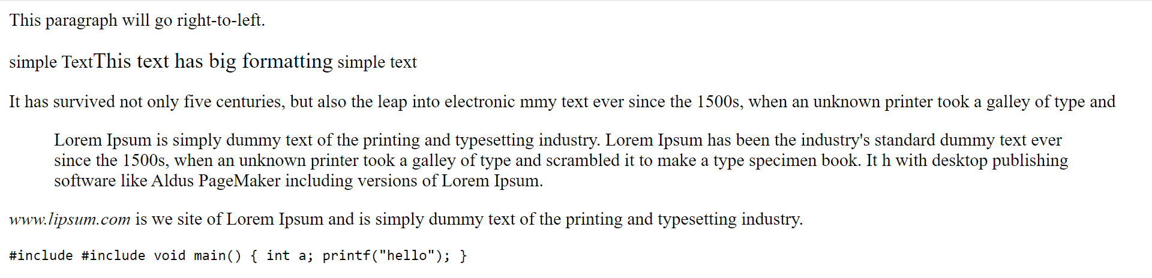

Slide 14
Some more Formatting Tags
<b> - Bold text
<strong> - Important text
<i> - Italic text
<em> - Emphasized text
<mark> - Marked text
<small> - Smaller text
<sub> - Subscript text
<sup> - Superscript text

Slide 15
HTML links- Hyperlinks
HTML links are hyperlinks.
You can click on a link and jump to another document.
When you move the mouse over a link, the mouse arrow will turn into a little hand.
** A link does not have to be text. A link can be an image or any other HTML element!**
Syntax: <a href="url">link text</a>
The most important attribute of the <a> element is the href attribute, which indicates the link's destination.
The link text is the part that will be visible to the reader.
Clicking on the link text, will send the reader to the specified URL address

